Slide 1
ALGORITHMS Sorting: Merge, Quick Sort
Asma Fariha
Lecturer, Department of Computer Science
American International University-Bangladesh (AIUB)
asma.fariha@aiub.edu

Slide 2
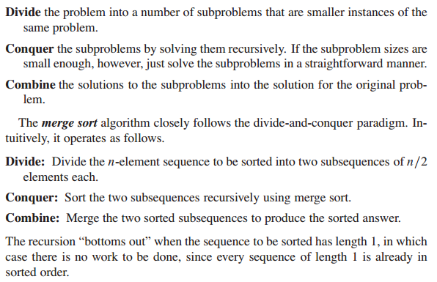
Merge Sort

Slide 3
Merge Sort
Mergesort(Passed an array)
if array size > 1
Divide array in half
Call Mergesort on first half.
Call Mergesort on second half.
Merge two halves.
Merge(Passed two arrays)
Compare leading element in each array
Select lower and place in new array.
(If one input array is empty then place
remainder of other array in output array)

Slide 4
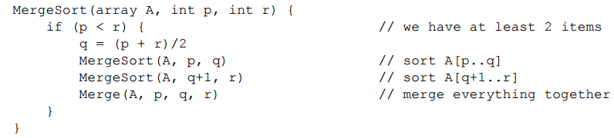
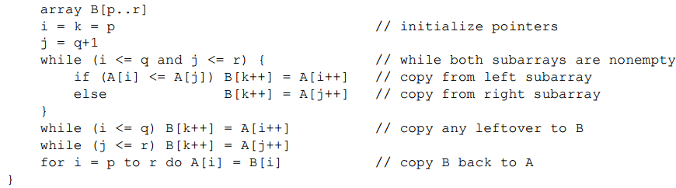
Merge Sort Pseudo-code

Slide 5
98
23
45
14
6
67
33
42

Slide 6
98
23
45
14
6
67
33
42
98
23
45
14
6
67
33
42

Slide 7
98
23
45
14
6
67
33
42
98
23
45
14
6
67
33
42
98
23
45
14

Slide 8
98
23
45
14
6
67
33
42
98
23
45
14
6
67
33
42
98
23
45
14
98
23

Slide 9
98
23
45
14
6
67
33
42
98
23
45
14
6
67
33
42
98
23
45
14
98
23
Merge

Slide 10
98
23
45
14
6
67
33
42
98
23
45
14
6
67
33
42
98
23
45
14
98
23
23
Merge

Slide 11
98
23
45
14
6
67
33
42
98
23
45
14
6
67
33
42
98
23
45
14
98
23
23
98
Merge

Slide 12
98
23
45
14
6
67
33
42
98
23
45
14
6
67
33
42
98
23
45
14
98
23
45
14
23
98

Slide 13
98
23
45
14
6
67
33
42
98
23
45
14
6
67
33
42
98
23
45
14
98
23
45
14
23
98
Merge

Slide 14
98
23
45
14
6
67
33
42
98
23
45
14
6
67
33
42
98
23
45
14
98
23
45
14
23
98
14
Merge

Slide 15
98
23
45
14
6
67
33
42
98
23
45
14
6
67
33
42
98
23
45
14
98
23
45
14
23
98
14
45
Merge

Slide 16
98
23
45
14
6
67
33
42
98
23
45
14
6
67
33
42
98
23
45
14
98
23
45
14
23
98
14
45
Merge

Slide 17
98
23
45
14
6
67
33
42
98
23
45
14
6
67
33
42
98
23
45
14
98
23
45
14
23
98
14
45
14
Merge

Slide 18
98
23
45
14
6
67
33
42
98
23
45
14
6
67
33
42
98
23
45
14
98
23
45
14
23
98
14
45
14
23
Merge

Slide 19
98
23
45
14
6
67
33
42
98
23
45
14
6
67
33
42
98
23
45
14
98
23
45
14
23
98
14
45
14
23
45
Merge

Slide 20
98
23
45
14
6
67
33
42
98
23
45
14
6
67
33
42
98
23
45
14
98
23
45
14
23
98
14
45
14
23
45
98
Merge

Slide 21
98
23
45
14
6
67
33
42
98
23
45
14
6
67
33
42
98
23
45
14
6
67
33
42
98
23
45
14
23
98
14
45
14
23
45
98

Slide 22
98
23
45
14
6
67
33
42
98
23
45
14
6
67
33
42
98
23
45
14
6
67
33
42
98
23
45
14
6
67
23
98
14
45
14
23
45
98

Slide 23
98
23
45
14
6
67
33
42
98
23
45
14
6
67
33
42
98
23
45
14
6
67
33
42
98
23
45
14
6
67
23
98
14
45
14
23
45
98
Merge

Slide 24
98
23
45
14
6
67
33
42
98
23
45
14
6
67
33
42
98
23
45
14
6
67
33
42
98
23
45
14
6
67
23
98
14
45
6
14
23
45
98
Merge

Slide 25
98
23
45
14
6
67
33
42
98
23
45
14
6
67
33
42
98
23
45
14
6
67
33
42
98
23
45
14
6
67
23
98
14
45
6
67
14
23
45
98
Merge

Slide 26
98
23
45
14
6
67
33
42
98
23
45
14
6
67
33
42
98
23
45
14
6
67
33
42
98
23
45
14
6
67
33
42
23
98
14
45
6
67
14
23
45
98

Slide 27
98
23
45
14
6
67
33
42
98
23
45
14
6
67
33
42
98
23
45
14
6
67
33
42
98
23
45
14
6
67
33
42
23
98
14
45
6
67
14
23
45
98
Merge

Slide 28
98
23
45
14
6
67
33
42
98
23
45
14
6
67
33
42
98
23
45
14
6
67
33
42
98
23
45
14
6
67
33
42
23
98
14
45
6
67
33
14
23
45
98
Merge

Slide 29
98
23
45
14
6
67
33
42
98
23
45
14
6
67
33
42
98
23
45
14
6
67
33
42
98
23
45
14
6
67
33
42
23
98
14
45
6
67
33
42
14
23
45
98
Merge

Slide 30
98
23
45
14
6
67
33
42
98
23
45
14
6
67
33
42
98
23
45
14
6
67
33
42
98
23
45
14
6
67
33
42
23
98
14
45
6
67
33
42
14
23
45
98
Merge

Slide 31
98
23
45
14
6
67
33
42
98
23
45
14
6
67
33
42
98
23
45
14
6
67
33
42
98
23
45
14
6
67
33
42
23
98
14
45
6
67
33
42
14
23
45
98
6
Merge

Slide 32
98
23
45
14
6
67
33
42
98
23
45
14
6
67
33
42
98
23
45
14
6
67
33
42
98
23
45
14
6
67
33
42
23
98
14
45
6
67
33
42
14
23
45
98
6
33
Merge

Slide 33
98
23
45
14
6
67
33
42
98
23
45
14
6
67
33
42
98
23
45
14
6
67
33
42
98
23
45
14
6
67
33
42
23
98
14
45
6
67
33
42
14
23
45
98
6
33
42
Merge

Slide 34
98
23
45
14
6
67
33
42
98
23
45
14
6
67
33
42
98
23
45
14
6
67
33
42
98
23
45
14
6
67
33
42
23
98
14
45
6
67
33
42
14
23
45
98
6
33
42
67
Merge

Slide 35
98
23
45
14
6
67
33
42
98
23
45
14
6
67
33
42
98
23
45
14
6
67
33
42
98
23
45
14
6
67
33
42
23
98
14
45
6
67
33
42
14
23
45
98
6
33
42
67
Merge

Slide 36
98
23
45
14
6
67
33
42
98
23
45
14
6
67
33
42
98
23
45
14
6
67
33
42
98
23
45
14
6
67
33
42
23
98
14
45
6
67
33
42
14
23
45
98
6
33
42
67
6
Merge

Slide 37
98
23
45
14
6
67
33
42
98
23
45
14
6
67
33
42
98
23
45
14
6
67
33
42
98
23
45
14
6
67
33
42
23
98
14
45
6
67
33
42
14
23
45
98
6
33
42
67
6
14
Merge

Slide 38
98
23
45
14
6
67
33
42
98
23
45
14
6
67
33
42
98
23
45
14
6
67
33
42
98
23
45
14
6
67
33
42
23
98
14
45
6
67
33
42
14
23
45
98
6
33
42
67
6
14
23
Merge

Slide 39
98
23
45
14
6
67
33
42
98
23
45
14
6
67
33
42
98
23
45
14
6
67
33
42
98
23
45
14
6
67
33
42
23
98
14
45
6
67
33
42
14
23
45
98
6
33
42
67
6
14
23
33
Merge

Slide 40
98
23
45
14
6
67
33
42
98
23
45
14
6
67
33
42
98
23
45
14
6
67
33
42
98
23
45
14
6
67
33
42
23
98
14
45
6
67
33
42
14
23
45
98
6
33
42
67
6
14
23
33
42
Merge

Slide 41
98
23
45
14
6
67
33
42
98
23
45
14
6
67
33
42
98
23
45
14
6
67
33
42
98
23
45
14
6
67
33
42
23
98
14
45
6
67
33
42
14
23
45
98
6
33
42
67
6
14
23
33
42
45
Merge

Slide 42
98
23
45
14
6
67
33
42
98
23
45
14
6
67
33
42
98
23
45
14
6
67
33
42
98
23
45
14
6
67
33
42
23
98
14
45
6
67
33
42
14
23
45
98
6
33
42
67
6
14
23
33
42
45
67
Merge

Slide 43
98
23
45
14
6
67
33
42
98
23
45
14
6
67
33
42
98
23
45
14
6
67
33
42
98
23
45
14
6
67
33
42
23
98
14
45
6
67
33
42
14
23
45
98
6
33
42
67
6
14
23
33
42
45
67
98
Merge

Slide 44
98
23
45
14
6
67
33
42
98
23
45
14
6
67
33
42
98
23
45
14
6
67
33
42
98
23
45
14
6
67
33
42
23
98
14
45
6
67
33
42
14
23
45
98
6
33
42
67
6
14
23
33
42
45
67
98

Slide 45
98
23
45
14
6
67
33
42
6
14
23
33
42
45
67
98

Slide 46
Summary
Divide the unsorted collection into two
Until the sub-arrays only contain one element
Then merge the sub-problem solutions together
Runtime Complexity : O(nlgn)
Storage Requirement: Double of that needed to hold the array to be sorted

Slide 47
Quicksort
Given an array of n elements (e.g., integers):
If array only contains one element, return
Else
pick one element to use as pivot.
Partition elements into two sub-arrays:
Elements less than or equal to pivot
Elements greater than pivot
Quicksort two sub-arrays
Return results

Slide 48
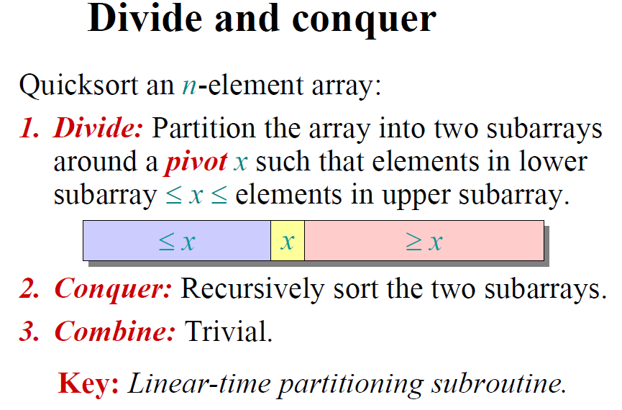

Slide 49
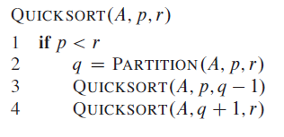
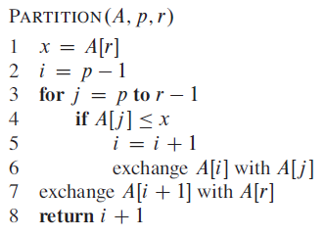
\\Array Last element as pivot

Slide 50
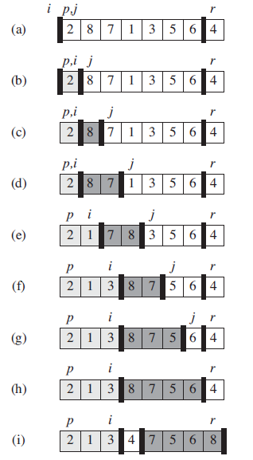
Array Last element as pivot

Slide 51
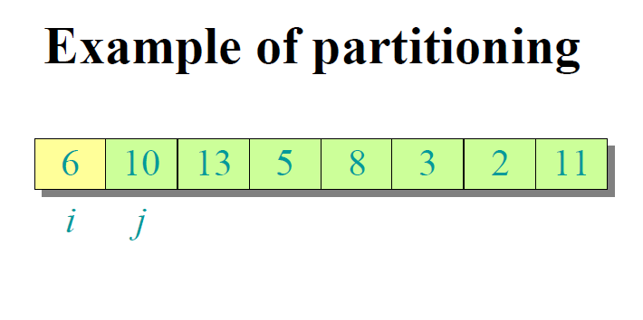
>Here Array first element is considered to calculate the pivot

Slide 52
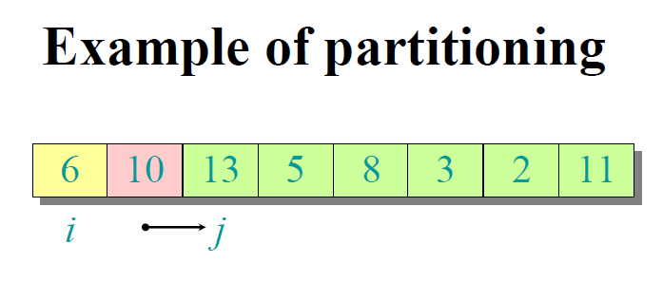

Slide 53
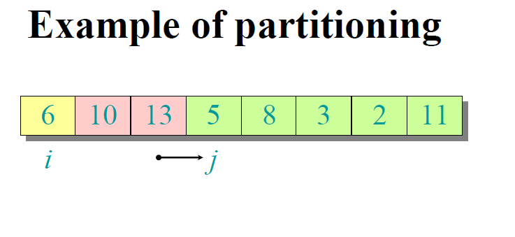

Slide 54
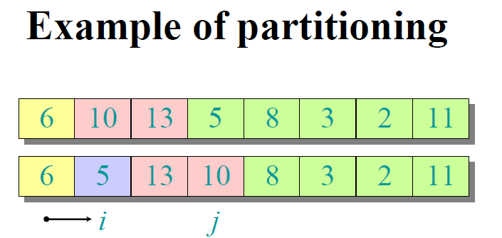

Slide 55
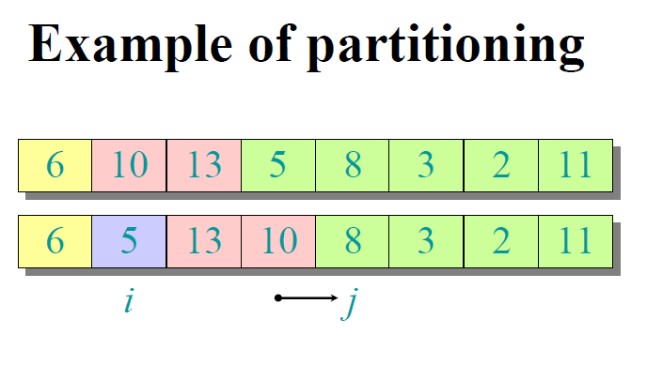

Slide 56
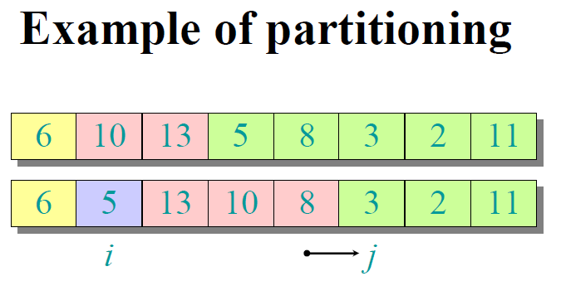

Slide 57
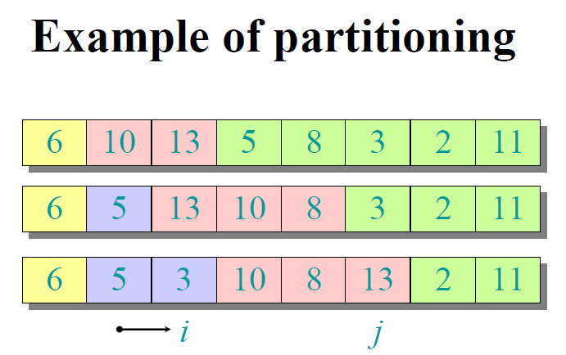

Slide 58
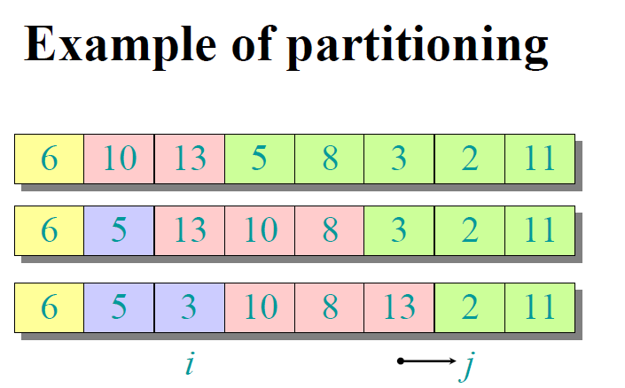

Slide 59
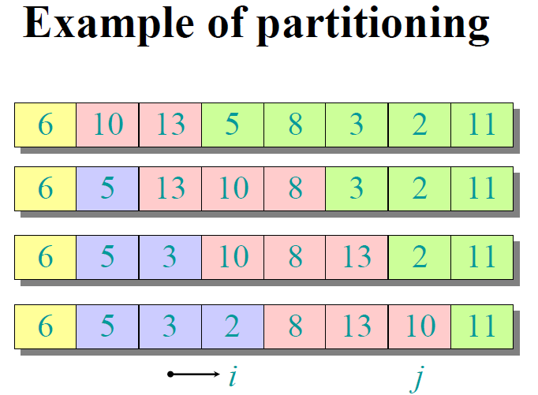

Slide 60
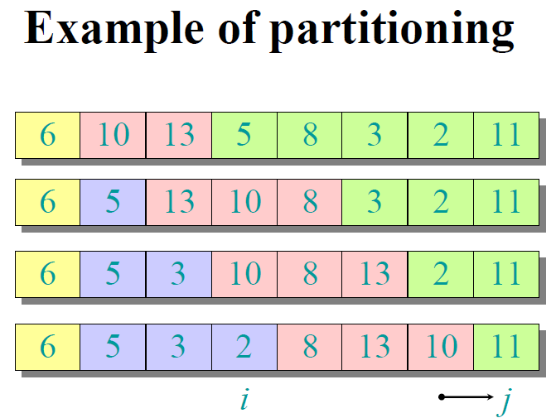

Slide 61
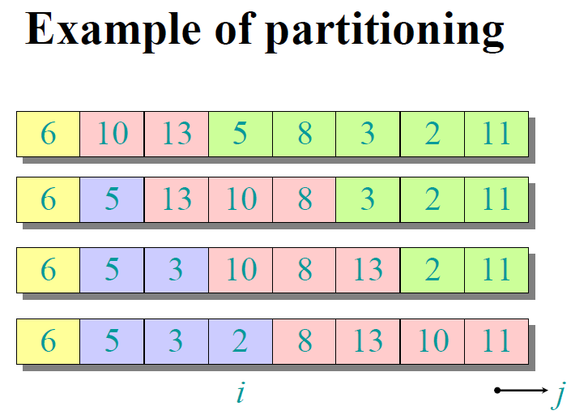

Slide 62
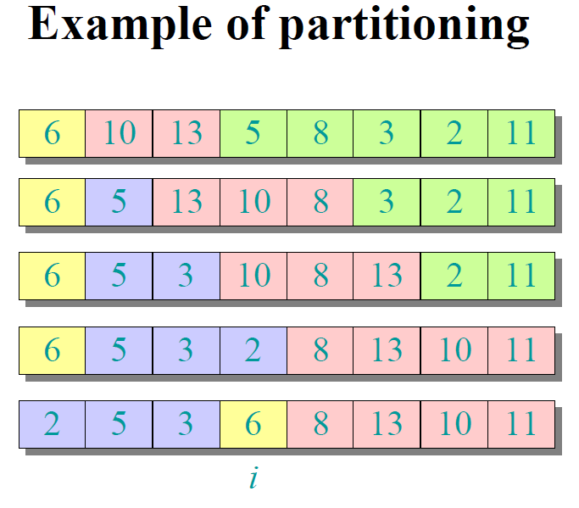

Slide 63
Quick Sort summary
Characteristics
sorts ”almost” in place, i.e., does not require an additional array, like insertion sort
Divide-and-conquer, like merge sort
very practical, average sort performance O(n log n) (with small constant factors), but worst case O(n²)

Slide 64
Exercise
Implement Quick-Sort, Merge Sort on below data set
n= 8, Data = 8, 7, 6, 5, 4, 3, 2, 1
n=9, Data = 3, 41, 52, 26, 38, 57, 9, 49, 40

